Slide 1

Automating Customer Support Tickets With RPA
Name 1: V.JYOTHEESHKAR REDDY Hall Ticket No: 18BF1A05H3
Name 2: ROWTHUPILLAI ISMAIL IRSHAD Hall Ticket No: 18BF1A05E1
Name 3: S.SUHANI ABBAS Hall Ticket No: 18BF1A05F3
Name 4: SATHYA NEIL CHOWDARY DARURU Hall Ticket No: 18BF1A05E7
UNDER THE GUIDANCE OF
Dr. R.Swathi,M.Tech,PhD
Associate Professor and Head of The Department,
DEPARTMENT OF COMPUTER SCIENCE AND ENGINEERING
SRI VENKATESWARA COLLEGE OF ENGINEERING
Karakambadi Road, Tirupati-517507
2022

Slide 2
Outline
Introduction
Abstract
Literature Survey
Problem Statement
Plan of Action
Objectives
Modules
Hardware Requirements
Software Requirements
UML Diagrams
Work Done
Result
Conclusion
References

Slide 3
Introduction
Customer support tickets can be overwhelming for human operators.
This can cause a lot of delay and may even lead to client’s having a bad relationship with the organization.
This project aims to increase the efficiency and speed of solving support tickets thereby leaving a better impression on the clients.

Slide 4
Abstract
Robotic process automation (or RPA or RPAAI) is an emerging form of clerical process automation technology which is based on the notion of software robots or on artificial intelligence (AI) workers. Robotic process automation (RPA) is the application of a technology that allows employees in a company to configure computer software or a robot to In such a manner so as to capture and interpret existing applications for processing a transaction, manipulating data, triggering responses, and communicating with other digital systems.
Robotic process automation is a particularly useful tool that allows organisations to automate business process thereby leading to an increase in efficiency. In many organizations, the IT support team usually has to deal with an enormous amount of help tickets that are being generated on a daily basis. These tickets could be raised regarding various issues.
This project proposes a model which allows tickets which have been raised repeatedly to gain access to a solution that has been tried and tested and as such is reliable. The implementation of this project on a large scale within an organization could easily save money and time. Instant replies also allows the organization to retain a good client relationship and fosters goodwill for the organization.

Slide 5
Literature Survey
The Process of automating the workflows with the help of robots/software to reduce the involvement of humans is said to be Robotic Process Automation.
Over here there are mainly three terms that need to be understood: Robotic, Process and Automation
Robotic: Entities which mimic human actions are called Robots.
Process: Sequence of steps which lead to a meaningful activity. For example, the process of making tea or your favorite dish, etc.
Automation: Any process which is done by a robot without human intervention

Slide 6
Literature Survey
If we summarize all the terms together then, mimicking human actions to perform a sequence of steps that lead to meaningful activity, without any human intervention is known as Robotic Process Automation.
The benefits of RPA are wide-ranging and far-reaching. You can put software robots to work to achieve significant and measurable improvements in areas of your business that range from customer satisfaction and employee engagement through to process speed, accuracy and cost efficiency.

Slide 7
Problem Statement
In any organization, a support team has to deal with an enormous amount of support tickets generated on a daily basis.
These support tickets could be raised on various issues. Now, each of these tickets have to be replied back immediately to maintain good client relationship.
Obviously, a manual employee cannot reply to all those emails single-handedly on a day to day basis. This would be quite tiresome and will cost a good amount of Time and money.

Slide 8
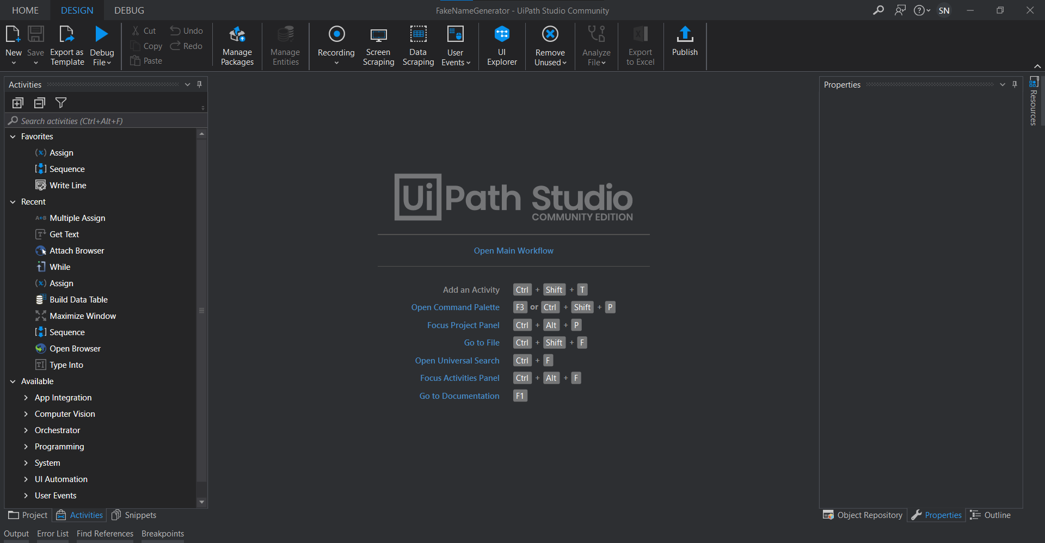
Problem Statement
This problem can be resolved
by using a leading RPA
software called UiPath. It is an
open-source software which can
Be used to automate the
responses of customer support
tickets.

Slide 9
Problem Statement
This will allow us to Increase Productivity, efficiency, security and Enhance accuracy and customer service.
Software is easily configured to automate activities and tasks.
Customer support tickets are rapidly resolved.

Slide 10
Plan of Action
To gather tickets from email and resolve them automatically
To record the resolved tickets in an excel sheet for further analysis
To perform a test to verify its efficiency
To correct the errors from the initial tests
To deploy the program for businesses

Slide 11
Objectives
Empowering Operational Efficiency
Perform rule based multi-system interactions with higher efficiency
Productivity Improvement
Handle the high volume of work as per stated rules
Eliminate Errors
Executes tasks with greater accuracy
Higher Employee Satisfaction
Give opportunity to work on more analytical jobs

Slide 12
Modules
Get Outlook Mail Message
This activity grabs your emails from the Outlook application and adds them to a list.
Move Outlook Mail Message
This activity will move an email to a specified folder.
Send Outlook Mail Message
By using the "SendOutlookMailMessages" activity, you are able to send an email from UiPath Studio.
Build Data Table
Creates a DataTable according to a specified schema.

Slide 13
Modules
The For Each activity
The For Each activity enables you to step through arrays, lists, data tables or other types of collections, so that you can iterate through the data and process each piece of information individually.
Sequences
Sequences are the smallest type of project. They are suitable to linear processes as they enable you to go from one activity to another seamlessly, and act as a single block activity.
The Assign activity
The Assign activity is an important activity that is going to be used quite often, as it enables you to assign a value to a variable

Slide 14
Modules
Multiple Assign
Performs multiple assign actions, enabling you to assign values to multiple variables without the need to use multiple Assign activities. A common use case for this activity is initialization before large processes, sparing the user of the need to configure multiple Assign activities
Add Data Row
Adds a DataRow to a specified DataTable.
Read Range activity
ReadRange Reads the value of an Excel range and stores it in a DataTable variable.
Write Range
WriteRange writes the data from a DataTable variable in a spreadsheet starting with the cell indicated in the StartingCell field.

Slide 15
Hardware Requirements
 | Minimum | Recommended
CPU cores | 2×1.6 Ghz 32-bit(×86) | 4×2.4 GHz 64-bit(×64)
RAM | 4 GB | 8 GB
Disk Space | 3.5 GB for new installations, 5 GB for upgrades | N/A

Slide 16
Software Requirements
Operating system | Windows 8/10/11
RPA Software | UiPath Studio
UiPath Version | UiPath Studio 2022.4.3
Spreadsheet software | excel
Excel version | excel 365

Slide 17
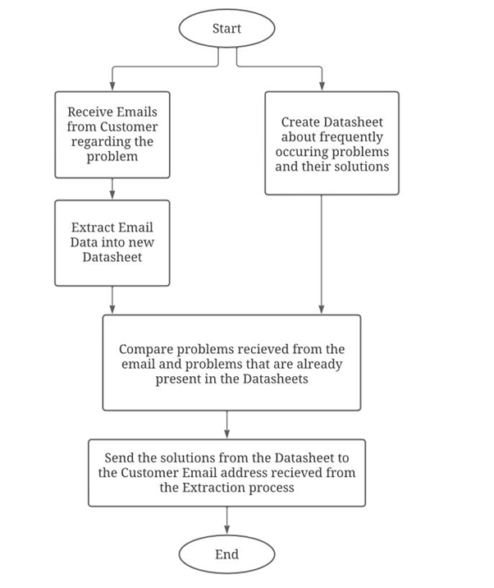
UML Diagram
The Unified Modeling Language (UML) is a standard language for specifying, Visualizing, constructing and documenting the artifacts of software systems, as well as for business modeling and other non-software systems.

Slide 18
Work Done
Created an excel sheet with relevant data.
Created a UiPath xaml file.
Added a component to link the excel sheet to the UiPath xaml file to grab data.
Added a component to read Emails.
Added a component to read tickets with existing solutions and send it back with the solution.

Slide 19
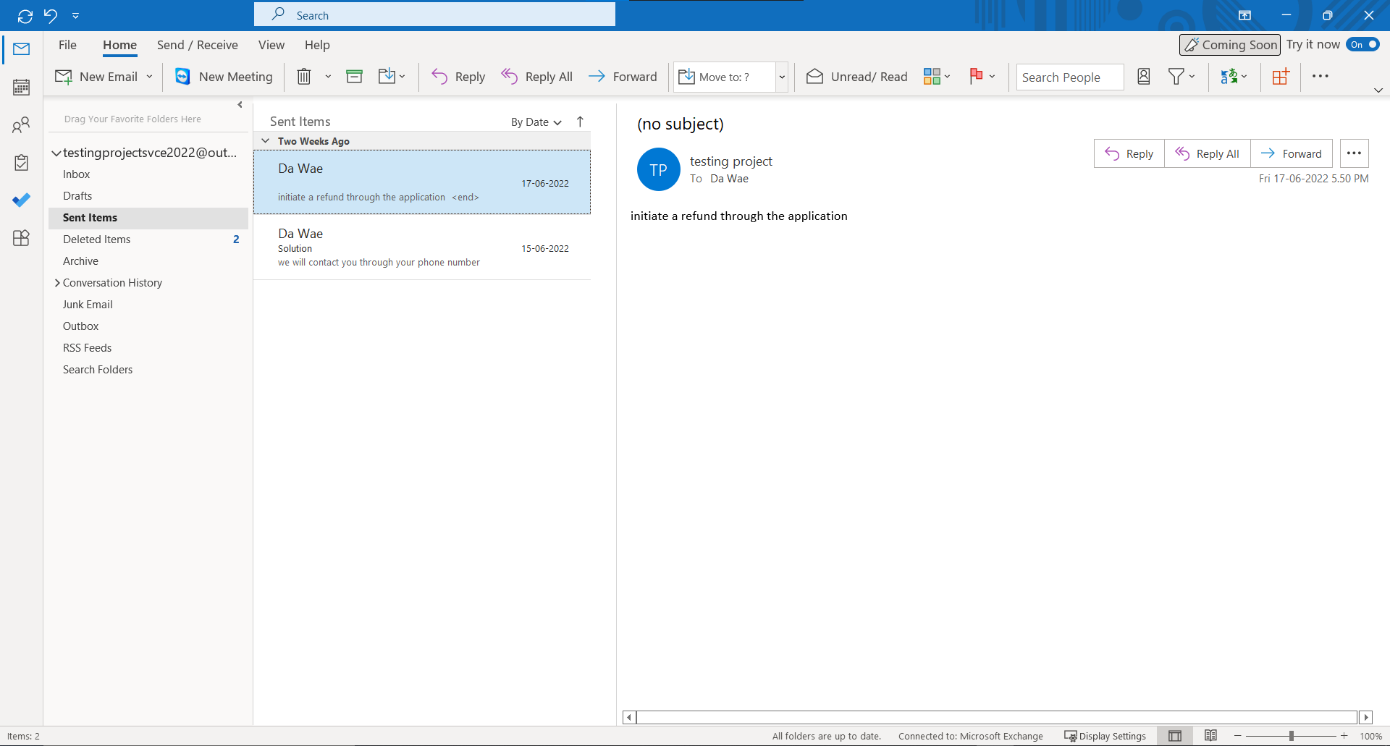
Result

Slide 20
Conclusion
Automating tasks to efficiently and quickly resolve customer support tickets using UiPath software.
Storing tickets to resolve future issues quickly and efficiently.

Slide 21
References
[1]Uipath.com. 2021. [online] Available at: <https://www.uipath.com/rpa/robotic-process-automation>
[Accessed 23 December 2021].
[2]Pollack Periodica, 2021. RPA progression throughout years and futuristic aspects of RPA.
[3]Taulli, T., 2020. The robotic process automation handbook. Berkeley, CA: Apress.
[4]AIMultiple. 2021. What is RPA? In-Depth Definition & Guide to RPA in 2022. [online] Available
at: <https://research.aimultiple.com/rpa/> [Accessed 23 December 2021].

Slide 22
Thank You

